Slide 1
Evaluation of an antibody to Alpha4Beta7 in the control of SIV infection
Michele Di Mascio, Jeffrey D. Lifson, Sharat Srinivasula, Paula DeGrange, Brandon Keele, Yuge Wang, Paolo Lusso, Michael Proschan, H. Clifford Lane, Anthony S. Fauci

Slide 2
Background
α₄β₇ is an integrin expressed on lymphocytes and is responsible for T-cell homing into gut-associatd lymphoid tissue thrugh binding to mucosal addressin cell adhesion molecule (MAdCAM)
CD4⁺ T cells that express high levels of the α₄β₇ integrin (α₄β₇^{hi}) are preferential targets of HIV and simian immunodeficiency virus (SIV) during acute infection
Administration of anti-α₄β₇ mAb before and during repeated low-dose intravaginal SIV challenge of rhesus macaques (RMs) leads to significant protection from transmission
It has recently been reported that combining ART with infusions of anti-α₄β₇ mAb (after two months of infection) led to prolonged virologic control following treatment discontinuation. Byrareddy et al. Science (2016).
Notes:
Why alfa4beta7? Because it is an important integrin expressed on lymphocytes and responsible for the T cell homing in lymphoid tissues, in particular the galt, a compartment in which there is high concentration of the receptor for a4b7, the madcam recptor.
Ten-15 years ago studies were conducted in vitro and then in vivo to show that cd4 t cells with high levels of a4b7 are preferential targets of HIV and SIV during acute infection
And so , at Emory University, few studies followed from those original observations to demonstrate that the administration of an anti-a4b7 mAb around the time of SIV infection was able to prevent transmission in a signifncat proportion of animals,//and also important observation in those studies was that the animals who got infected showed also lower viral dissemination in tissues
In 2016, the same team from Emory showed that the administration of the same anti-a4b7 mAb, but this time two months after the infection and at a time when ART had already started in the infected subjects, was able to avhieve prolonged virologic control following treatment discontinuation

Slide 3
Purpose
Given the potential importance of the combination of an anti- α₄β₇ antibody and ART therapy in inducing an ART-free remission and the commercial availability of a licensed human monoclonal antibody to α₄β₇ (Vedolizumab) two studies were undertaken:
A study of Vedolizumab in HIV infected individuals (preliminary data to be presented Wednesday by Dr. Fauci in Session WESS01; Hall 12 13:00)
A study to confirm and extend the published non-human primate study (the present study)
Notes:
Clearly an important observation.., first of all for its potential in inducing art-free remission, and second because of the avialabilty of the equivalent of an anti-a4b7 mab for human studies (I am referring to the Vedolizumab, used for the treatment of IBD); for this reason, two studies were undertaken from our programs.

Slide 4
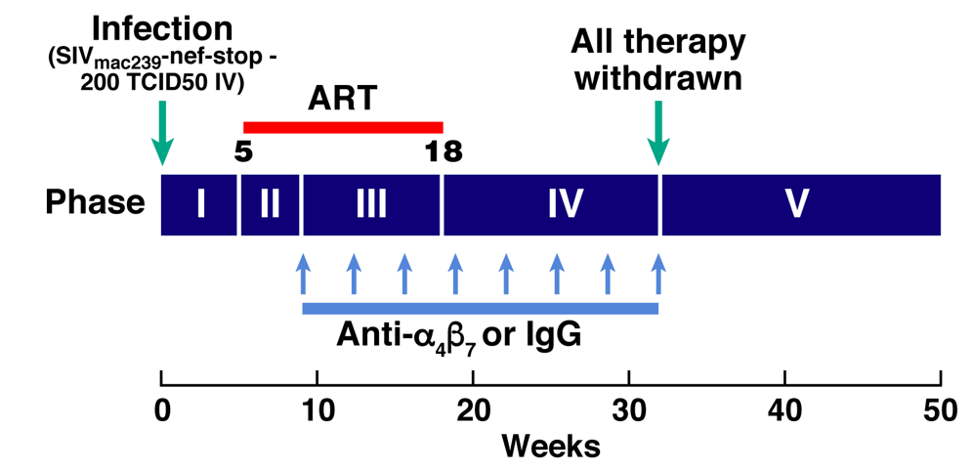
Methods (1)
Twenty-two juvenile to adult Indian rhesus macaques negative for Mamu -A001,-B008 and –B017 alleles, and infected intravenously with 200 TCID₅₀ of SIVmac239nefstop (courtesy F. Villinger)
Five weeks post infection combination antiretroviral therapy (ART) was started with tenofovir, emtricitabine and L-870812 (integrase inhibitor)
Notes:
Twenty-two Indian rhesus macaques negative for the Mamu A-001,-B008 and –B017 alleles [that are known associated with an increased frequency of spontaneous viral control], were infected intravenously with 200 TCID₅₀ of SIVmac239nefstop which was provided by courtesy of Francois Villinger. This was the same viral stock, inoculated in the same manner, and using the same dose as reported by Byrareddy et al. All animals started ART at 5 weeks post infection (2 RTIs and one Integrase inhibitor under study at Merck).

Slide 5
Methods (2)
Four weeks following initiation of ART the animals were randomized for sex, weight and AUC viral load (from day 0) to receive infusions of a primatized anti-α₄β₇ or a control antibody to a total of 8 infusions
Following the fourth infusion (18 weeks post infection) ART was stopped.
anti- α₄β₇ antibody levels in the plasma were measured using ELISA (D. Barouch)
Plasma SIV RNA levels and CD4+ T cell counts were monitored approximately every 2 weeks for ∼ one year.

Slide 6
Methods (3)
The study used the same virus, ART regimen, anti-α₄β₇ antibody preparation and study design as Byareddy et al
Anti-drug antibody levels were measured by ELISA (K. Reimann)
Samples size: n=12 (Active), n=10 (Control)
Notes:
.

Slide 7
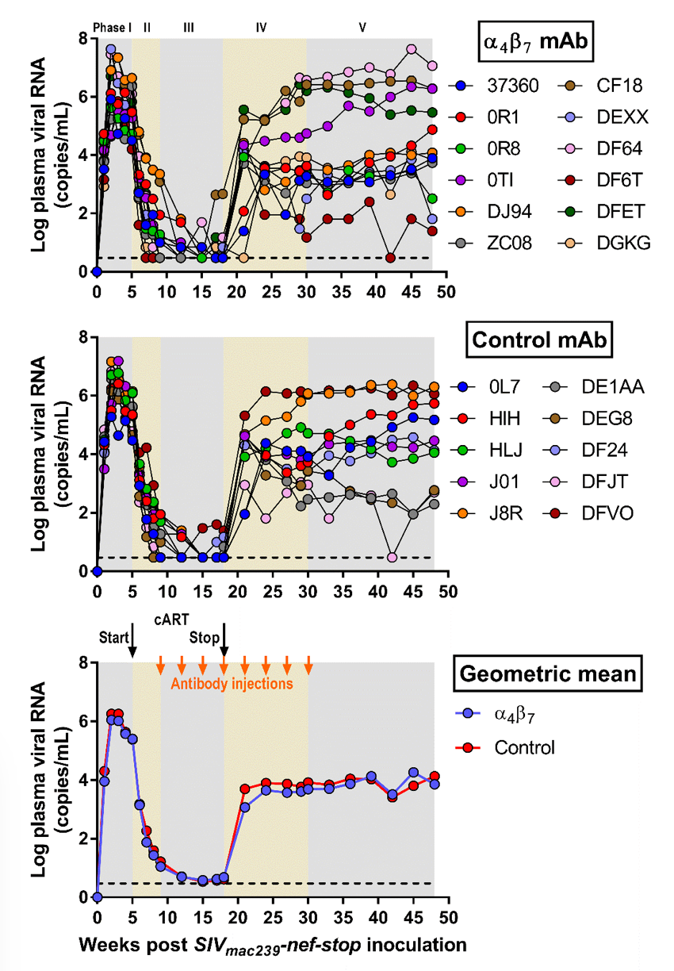
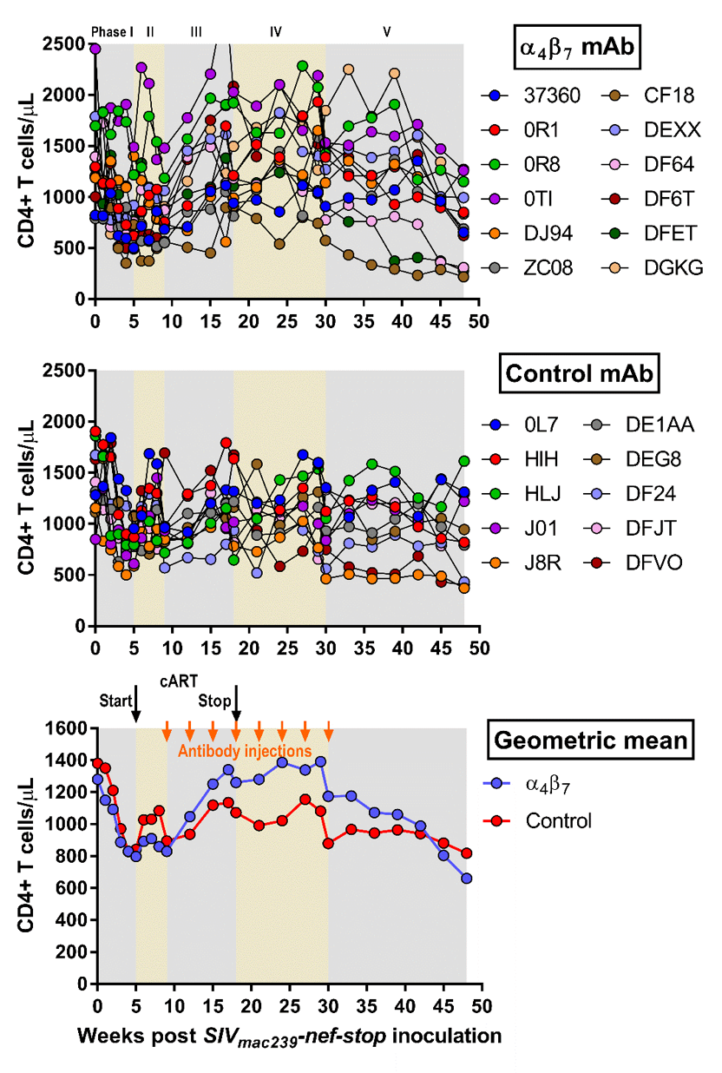
Plasma SIV RNA Levels
Peripheral Blood CD4 Counts
Notes:
And here are the plasma SIV levels for individual animals for the active (a4b7 mAb) group and the control group, and the geometric means in the bottom panel.
In contrast to Byrareddy et al, we did not observe evidence for better control of viral replication after treatment interruption in the animals treated with α4β7 antibody ; indeed there was no significant difference between the experimental groups.
On the right panel we are showing the CD4+ T cell counts. As you can see, we observed a transient increase in CD4 counts in active group, but only during the Ab treatment period, --- this difference did not persist after Ab treatment was discontinued.
So in our study we have not seen the same phenomenon reported from the Emory team. But before moving to the next slide, I would ike you to look closer at these virologic set-points, quite spread from 2 to 7 logs in both groups…

Slide 8
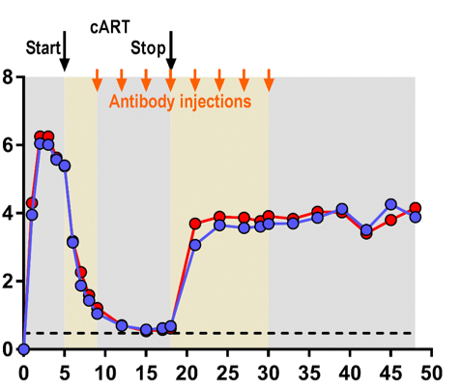
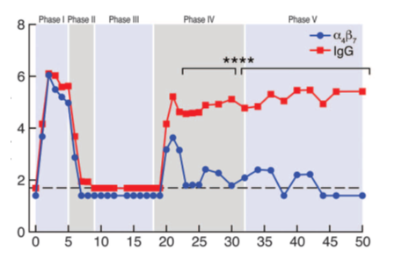
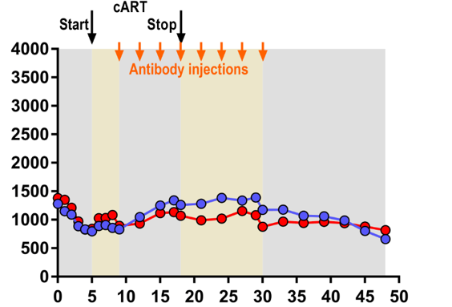
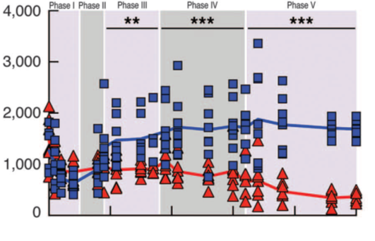
Byrareddy et al
Our study et al
Notes:
Let’s focus one moment on the difference in the primary outcome of the experimental design between our study and the Emory study
The Emory study reports a clear difference in both viremia and cd4 counts between active and control groups at set point; which we do not see. But there is something else that is different and that stroke our attention.
Our control group showed approx. 2 log lower viremia than the control group from Emory (top panelns) and approx 400 to 500 higher levels of cd4 counts than the Emory control group at set point, so approx. 6-7 months from interruption of therapy.
So, by just focusing on the control groups, it ooks like this virus is more virulent in the Emory hosts than our hosts.
Are there reasons to believe that this virus could estabkish such variable progressions among hosts of the same specicies (after we exclude of course those protective haplotypes that are known to be associated with benign progression, as done in our studies)?

Slide 9
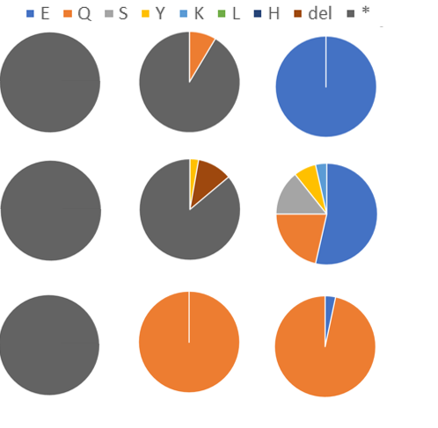
Variable Kinetics and Pathways of Nef-STOP Repair
viral
inoculum
week 2 p.i.
week 5 p.i.
SGA sequencing of Nef region
25-60 clones sequenced per animal per timepoint
At 2 wpi Nef-Stop ranged from 0-91% of sequences
By 5 wpi, no Nef-STOP remained, but STOP was repaired using variable amino acids, with E, Q, and S most common
Impact of variation in Nef-STOP repair kinetics and pathways on viral dynamics and outcome in these animals is uncertain
HIH
J01
DEXX
Negative correlation found between %SIVmac239nef-stop and plasma viral load at week 2 p.i. (s.r.c.= -0.67 , P <0.001)
Notes:
Yes, there are reasons. The virus used in both the Byrareddy et al study, and the present study was not wild type SIVmac239, but rather SIVmac239 Nef-STOP, This virus has a stop codon in the Nef gene, resulting in a non functional nef. In vivo, this stop codon is repaired through cycles of reverse transcriptions , but with variable kinetics. So we performed Single Genome Amplification sequencing at both 2 weeks post-infection and 5 weeks post-infection. The virus stock used to challenge the animals contained 100% Nef-STOP (thebaseline pie chart has the same full dark grey color for all), as shown in these 3 representative animals.
While at week 5 there is no presence of the nef-stop virus in any iof the 22 animals of our stuidy, At 2 weeks post-infection Nef-STOP is still quite visible in the pie charts, ranging between 0% and 91% in different animals. This variability in the timing of nef-repair is important, because repairing nef is expected to lead to a more fit or virulent virus, as in fact captured by the inverse correlation found between the % of sivmac239nef-stop virus present in the plasma of animals at week 2 p.i. and its viral load at the same time point.
The potential impact of variation in Nef-STOP repair kinetics in explaining the differential outcomes in the two studies is unknown, but thisnef-stop elemtn in the experimental design could well be responsible for the wide range in virologic setpoints observed in this study,
Do we have any evidence that faster viral replication during those early days do impact on the virologic set point?

Slide 10
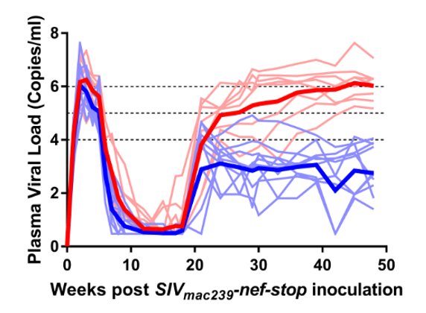
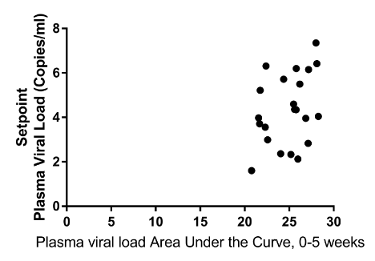
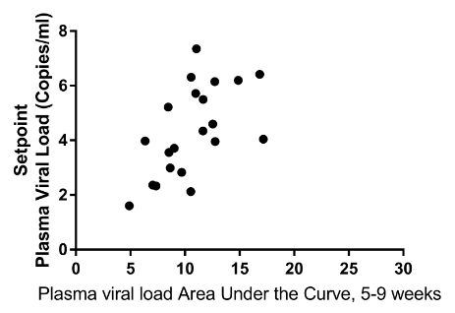
Early viral dynamics (prior to anti-α₄β₇ mAb ) predict viral set-point, independently of the anti-α₄β₇ mAb treatment
start of ART
4 (Active)
1st mAb
8
4 (Control)
6 (Active)
10
4 (Control)
ρ=0.38, n=22
p=0.042
ρ=0.62, n=22
p=0.001
Notes:
Yes we do, if we cluster our animals based on those that achieved greater than 5 log viremia at set point (red curves), and those with less than 4 log viremia (blue curves), we can see that those wth more bengn progression are also those with lower replication during the course of acute infection. While the peak viremia is not associated to the set point, the AUC from day zero to week 5 (day in which art started) is stat shows signinf correlation with viral set point in the entire group of n=22 animals.
If we zoom a little bit further, we can see that what happens during the first weeks of HAART, specifically how fast the virus decays during haart, is also predictor (and even higher) of virlogic set point.
Now, 8 are the animals achieving more than 5 log viremia – of these, …4 belong to the active and 4 to the control group..
10 animals achieved less than 4 log viremia\of these….4 belonged to the active group and 4 to the control group.
It shows from another angle, that the anti-alfa4beta7 had little contribution in deteriinig the fate of progression in this group of animals

Slide 11
Conclusions
In a study design similar to Byareddy, et al, using the same virus, ART regimen, and anti-α₄β₇ antibody preparation, we did not see any effect of treatment with anti-α₄β₇ on viral load following ART discontinuation.
The difference in results from those reported by Byrareddy et al is not explained by the viral stock, lot of antibody used or development of anti-drug antibodies.
Genetic or other differences in the macaques studied or other factors, including differences in virus/host balance related to differential kinetics and pathway of Nef-STOP repair, may have contributed to the different results observed.

Slide 12
ACKNOWLEDGEMENTS/COLLABORATORS
NIAID
ACVP/FNL*
Christine Fennessey
Carolyn Reid
Laura Newman
Leslie Lipkey
Randy Fast
Kelli Oswald
Rebecca Shoemaker
Brandon Keele
Jeff Lifson
Harvard/BIDMC/Ragon
Dan Barouch
Sharat Srinivasula (FNL)
Insook Kim (FNL)
Paula DeGrange (Battelle)
Andrew Bonvillian (Battelle)
Amanda Tobery (Battelle)
Paolo Lusso
Yuge (Bill) Wang
Mike Proschan
Marisa St Claire
Cliff Lane
Anthony Fauci
U Mass
Keith Reimann
Leidos Biomedical Research
FNL
Refika Turner
Ludmila Krymskaya
Michael Davies
acknowledgements
Division of Veterinary Resources, NIH
Aftab Ansari, Emory U
Sid Byrareddy, Emory U
Francois Villinger, Emory U
Claudia Cicala, NIAID
Jim Arthos, NIAID
*contract HHSN261200800001E
Notes:
.

